Slide 2
CSE115
Lecture 18
Dr. Mohammad Abu Yousuf (MAY)

Slide 3
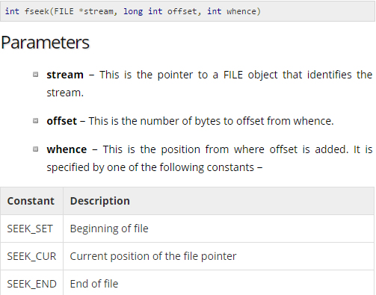
Example of fread, fwrite, fseek

Slide 4
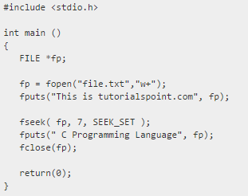
Output:
This is C Programming Language

Slide 5
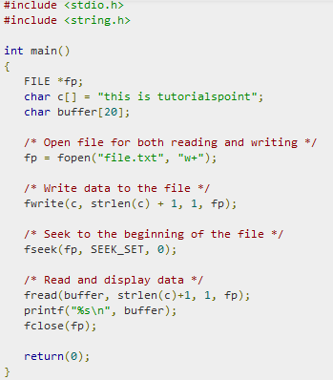
Output:
this is tutorialspoint

Slide 6
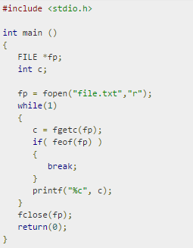
Find output

Slide 7
Output:

Slide 8
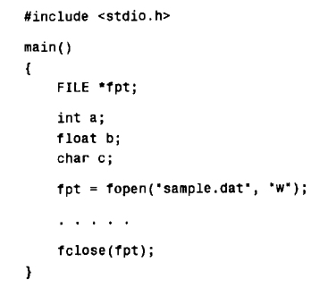
Enter values for a, b and c from the keyboard, in response to prompts generated by the program. Then write the values to the data file. Format the floating-point value so that not more than two decimals are written to the data file.

Slide 9

Output

Slide 10
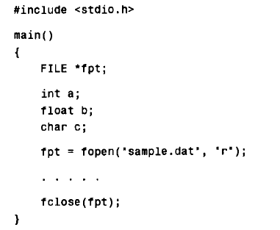
Read the values of a,b and c from the data file and display them on the screen.

Slide 11

Output

Slide 12
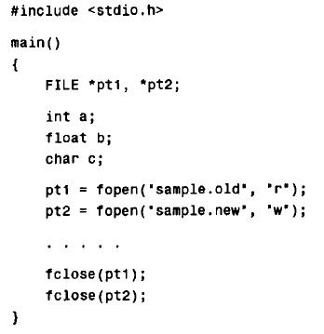
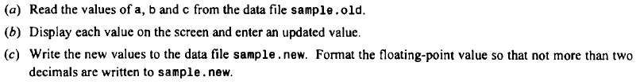

Slide 13
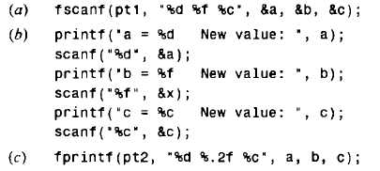
Output:

Slide 14
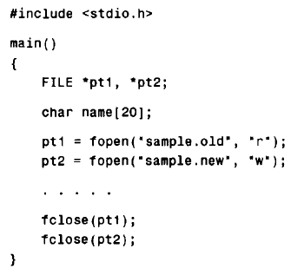
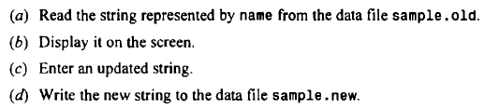

Slide 15
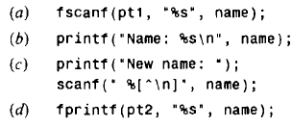
Output:

